Slide 1


Major Project Presentation
HEALTHMATE
Under Supervision of
Mrs. Pallavi Shukla
Aman Pratap Singh
Aniket Pandey
Harsh Srivastava
Shaurya Mishra
2100101530013
2100101530017
2100101530031
2100101530050

Slide 2
Outline
INTRODUCTION
OBJECTIVES
LITERATURE REVIEW
METHODOLOGY USED
DATA FLOW DIAGRAM
PROGRESS & RESULT
FUTURE WORK
CONCLUSION
REFERENCES

Slide 3
Introduction
In today’s world, maintaining a healthy lifestyle can be challenging. It’s essential to monitor your dietary intake, ensuring you consume the right amount of calories and maintain a well balanced diet.
Keeping this in mind we are introducing-
Health-Mate your AI powered fitness companion
AI-Powered Nutritional Analysis: Snap a picture of your meal and Health-Mate will provide detailed nutritional content instantly.
Personalized Food Tracking: Automated tracking of your food intake with real-time calorie updates, tailored to your goals.

Slide 4
Calorie Alerts: Get notified when you're nearing your daily calorie limit, customized for weight loss, maintenance, or muscle gain.
Customized Workout Plans: Receive fitness recommendations based on your diet and objectives—strength training, cardio, yoga, and more.
Interactive Chatbot, Nutro: Virtual assistant offering recipe ideas, health tips, and motivation, available on any device.
Cross-Platform Compatibility: Seamless experience across smartphones, tablets, and desktops

Slide 5
Objectives
The objective of Health-Mate AI tool is to comprehensively monitor and analyze your daily calorie intake. It provides detailed information on the calorie content and nutrient composition of various food and beverage items.
It’s ultimate aim is to help individual maintain a balanced diet, achieve their fitness goals, and promote overall health and well-being.
It offers insights into both quantity and calories and types of nutrients consumed by individuals.

Slide 6
Literature Review
1. Health Applications and Dietary Management:
Food Tracking and Self-Monitoring: Numerous studies have highlighted the effectiveness of food tracking apps in promoting weight loss and improved dietary habits. Research by Carter et al. (2013) demonstrated that self-monitoring, particularly through mobile apps, significantly increases awareness of food intake and facilitates behavior change.
Citation: Carter, M. C., Burley, V. J., Nykjaer, C., & Cade, J. E. (2013). Adherence to a smartphone application for weight loss compared with website and paper diary: pilot randomized controlled trial. Journal of medical Internet research, 15(4), e32.

Slide 7
2. Personalized Dietary Recommendations
The ability to provide personalized dietary recommendations based on individual needs and preferences is crucial for long-term adherence. Research by Paglialonga et al. (2019) emphasizes the importance of tailoring dietary interventions to individual characteristics, such as genetics, lifestyle, and health conditions.
Citation: Paglialonga, A., Santoro, A., Guidetti, L., & Donini, L. M. (2019). Personalized nutrition: a systematic review. International journal of food sciences and nutrition, 70(7), 785-797.

Slide 8
3. Artificial Intelligence in Health Interventions
Personalization and Adaptation: AI algorithms can analyze user data to provide personalized recommendations and adapt interventions based on individual progress and preferences. Research by Kumar et al. (2019) highlights the potential of AI in tailoring health interventions to enhance user engagement and adherence.
Citation: Kumar, S., Nilsen, W. J., Abernethy, A., Atienza, A., Patrick, K., Pavel, M., ... & Swendseid, D. (2019). Mobile health technology for health care research and clinical applications. Circulation, 139(18), 2100-2112.

Slide 9
Methodology Used
Health-Mate: Project Overview
1. Objectives
Nutritional Analysis – AI-powered food recognition for instant calorie & nutrient insights. Personalized Food Tracking – Smart logging with adaptive ML-based recommendations. Workout Recommendations – Tailored fitness plans aligned with dietary intake. Interactive Chatbot (Nutro) – Engaging AI assistant for advice & motivation.
2. Scope
Image Processing – OpenCV for food image analysis. Nutritional Analysis – CNNs for accurate food recognition. Machine Learning – Adaptive meal recommendations. Workout Planning – AI-driven exercise suggestions.

Slide 10
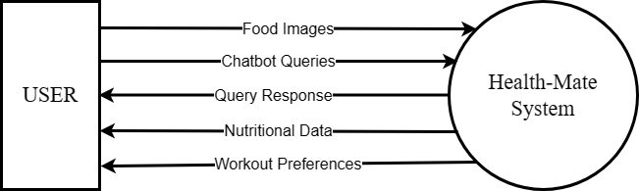
Data Flow Diagram (0)

Slide 11
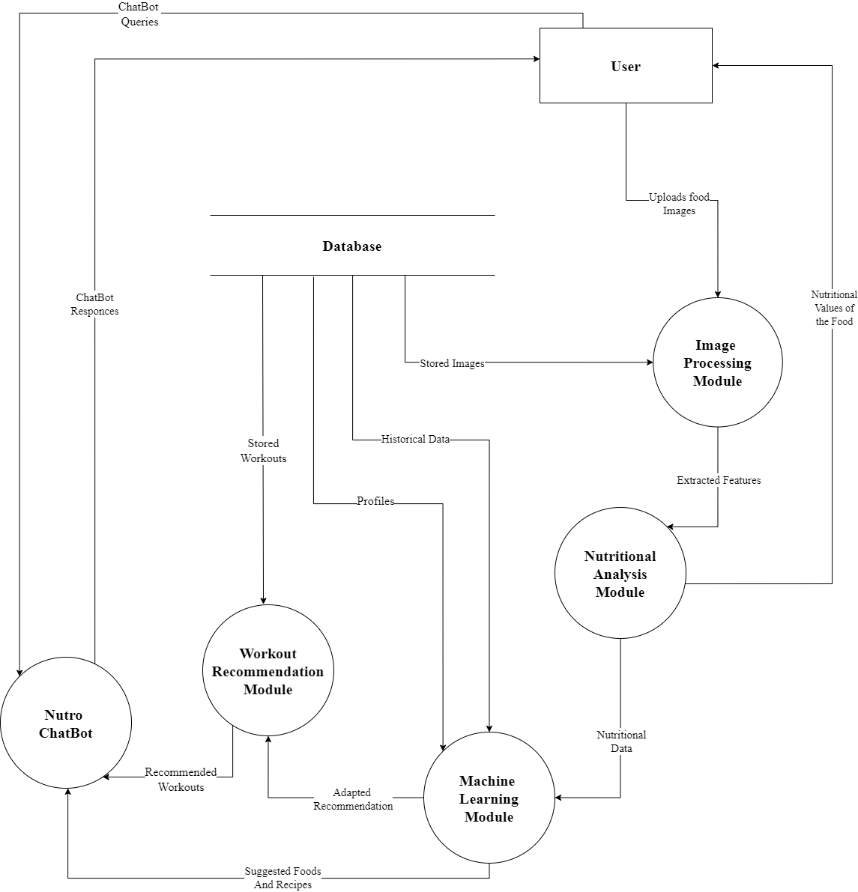
Data Flow Diagram - 1

Slide 12
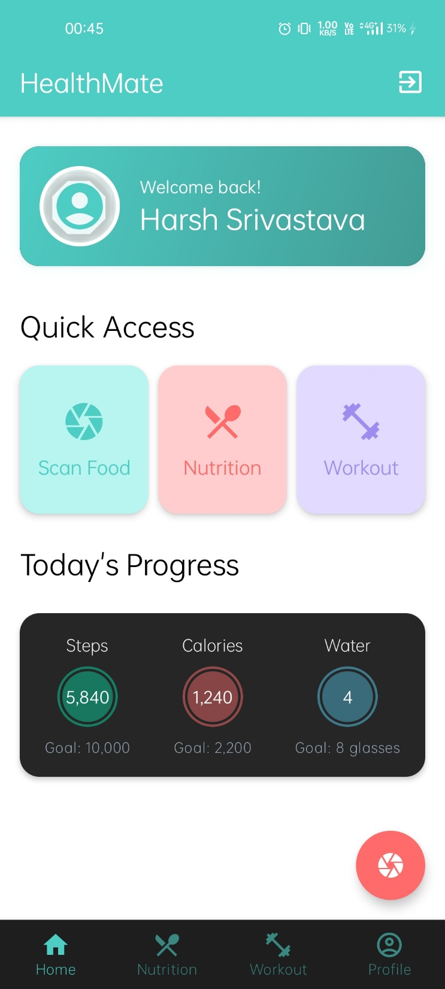

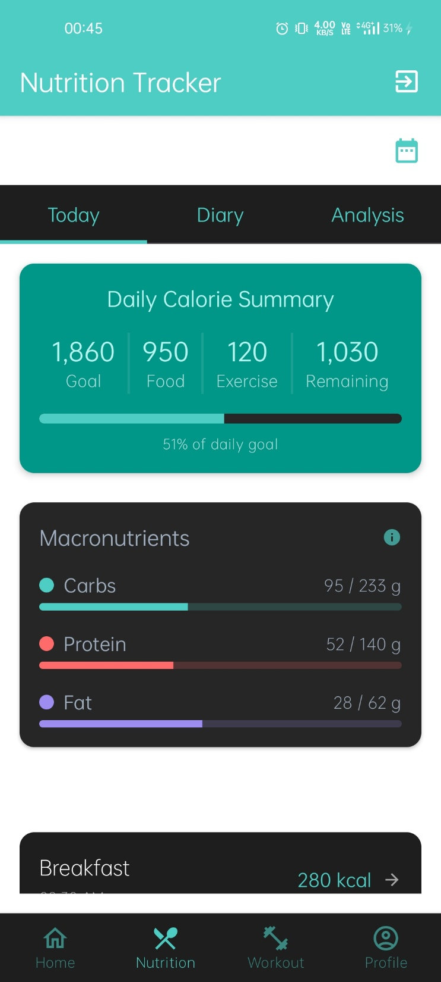
SNAPSHOTS OF THE APP

Slide 13
Future Work
Enhanced AI Model for Food Recognition -Improve accuracy in identifying and analyzing diverse meals from different cuisines. Integrate machine learning to understand regional and cultural food variations.
Real-Time Nutritional Feedback- Implement a feature for real-time nutrient tracking while eating. Provide live guidance for balancing meals with personalized health goals.
Expanded Customizable Workout Plans- Include more fitness types (e.g., yoga, pilates, sports-specific routines).Integrate with wearable devices for real-time activity tracking and adaptive plans.

Slide 14
Future Work
AI-Driven Meal Recommendations - Suggest personalized recipes based on dietary preferences and health objectives.Enable shopping list creation and integration with food delivery services.
Social & Community FeaturesIntroduce a social platform to share progress, meal ideas, and workout routines.Create challenges and progress tracking with friends or health

Slide 15
Conclusion
In conclusion, HealthMate is a comprehensive, user-friendly app designed to empower individuals on their fitness journey. By offering personalized workout and dietary plans, along with the ability to scan food images and instantly determine calorie content.
HealthMate provides a holistic approach to health management. With its tailored solutions, it enables users to stay on track, make informed choices, and ultimately achieve their fitness goals more efficiently.
The app bridges the gap between knowledge and action, ensuring that users have all the tools they need to lead a healthier, more active life. Thank you for your attention, and we believe that HealthMate is truly a game-changer in the world of fitness and nutrition.

Slide 16
References
[1] Mitchell T. 1997. “Machine Learning”. McGraw Hill.
[2] Russell S and Norvig P, 2009. “Artificial Intelligence: A Modern Approach”. Third Edition, Prentice Hall.
[3] Jurafsky D and Martin J H, 2014. “Speech and Processing: An Introduction to Natural Language Processing, Computational Linguistics and Speech. Pearson Publication.
[4] Pressman R. Software Engineering: A Practitioners Approach. McGraw Hill.
[5] Website – https://www.geeksforgeeks.org/opencv-python-tutorial/

Slide 17
THANK YOU

